Slide 1
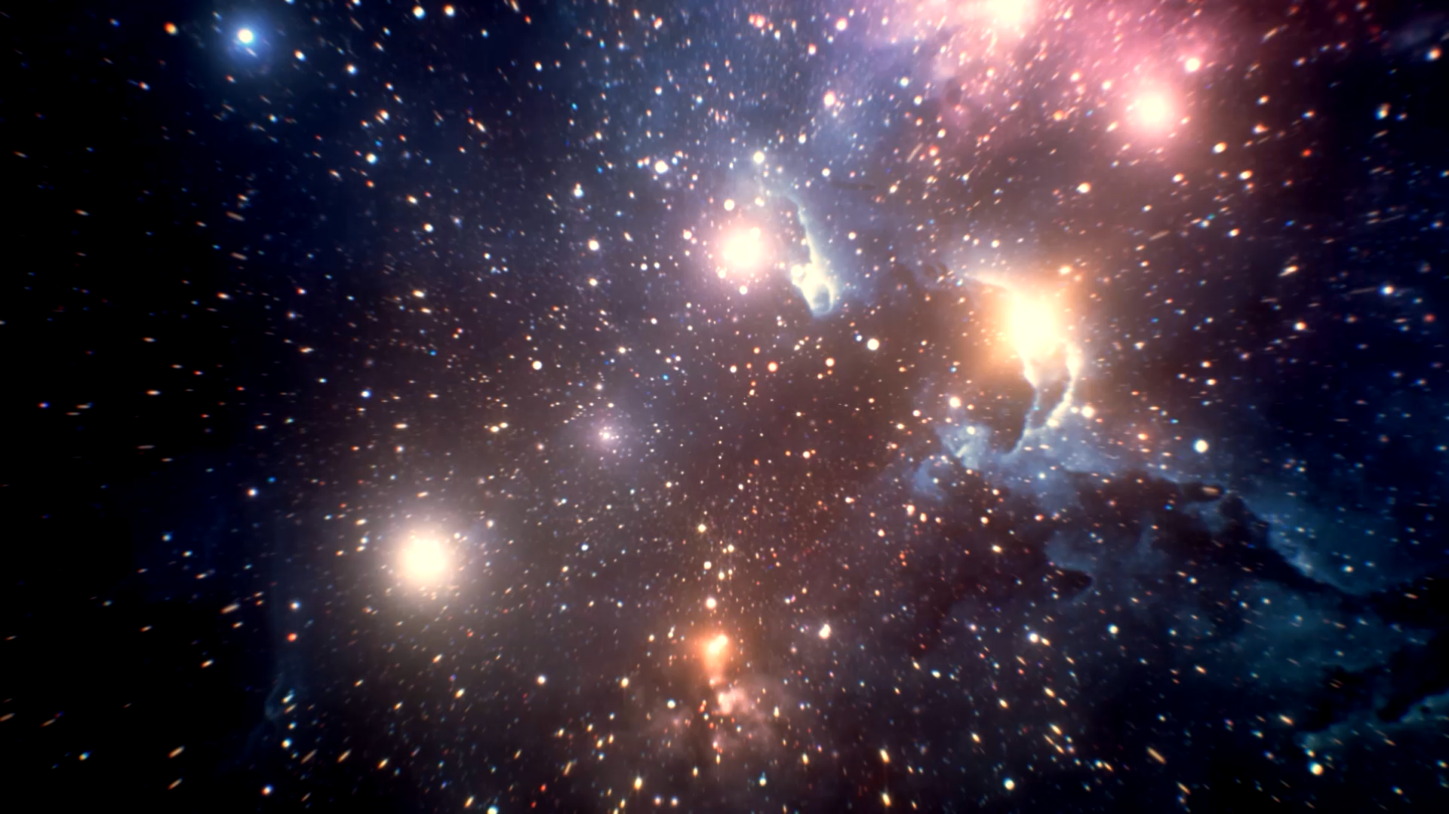
Falling Apples and Orbiting Planets
The Universe
IS #2

Slide 2
Lecture Recap
What is one thing you remember from the lecture?

Slide 3

Romeo and Juliet
Featuring euler
And cromer

Slide 4

Euler’s Method

Slide 5
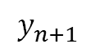
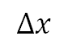
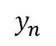
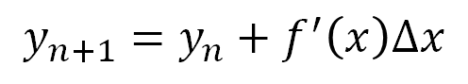
Euler’s Method
To estimate the next point:
Find where we are
Find how steep it is
Approximate how much higher/lower we will go
$$y_{n+1}$$
$$y_{n}$$
$$y_{n+1}=y_{n}+f^{′}\left(x\right)Δx$$
$$Δx$$

Slide 6
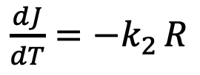
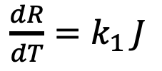
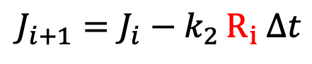
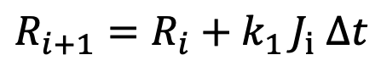

Euler Method
With two coupled differential equations
$\frac{dR}{dT}=k_{1 }J$
$$\}$$
$$R_{i+1}=R_{i}+k_{1 }J_{i} Δt$$
$\frac{dJ}{dT}={−k}_{2 }R$
$$J_{i+1}=J_{i}−k_{2 }R_{i} Δt$$

Slide 7
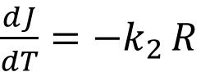
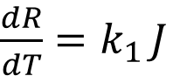
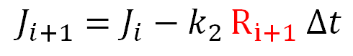
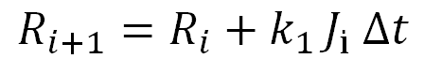

Euler-Cromer Method
With two coupled differential equations
$\frac{dR}{dT}=k_{1 }J$
$$\}$$
$$R_{i+1}=R_{i}+k_{1 }J_{i} Δt$$
$\frac{dJ}{dT}={−k}_{2 }R$
$$J_{i+1}=J_{i}−k_{2 }R_{i+1} Δt$$

Slide 8
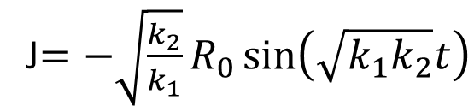
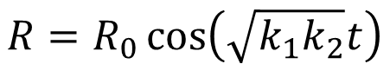
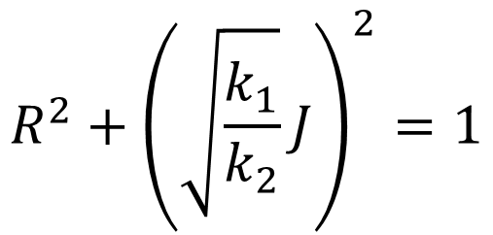
Conserved Quantity
J$={−\sqrt{\frac{k_{2}}{k_{1}}}R}_{0}\sin\left(\sqrt{k_{1}k_{2}}t\right)$
$$R=R_{0}\cos\left(\sqrt{k_{1}k_{2}}t\right)$$
$$R^{2}+{\left(\sqrt{\frac{k_{1}}{k_{2}}}J\right)}^{2}=1$$
Equation of an ellipse!

Slide 9
Euler vs Euler-Cromer
Plot Romeo against time (Euler/Euler-Cromer + Exact)
Plot Juliet against time (Euler/Euler-Cromer + Exact)
Plot Romeo against Juliet (Euler/Euler-Cromer + Exact)

Slide 10
Pseudocode
Euler Method:
Set Romeo and Juliet as lists with their initial conditions
Define the time step
Set a for loop to iterate many times:
Define, at each time step, the change in Romeo and Juliet
Update the values of Romeo and Juliet by adding in their respective changes
Plot Romeo and Juliet over time
Euler-Cromer Method:
Set Romeo and Juliet as lists with their initial conditions
Define the time step
Set a for loop to iterate many times:
Define the change of Romeo using old Juliet and Update Romeo
Define the change of Juliet using new Romeo and Update Juliet
Plot Romeo and Juliet over time

Slide 11
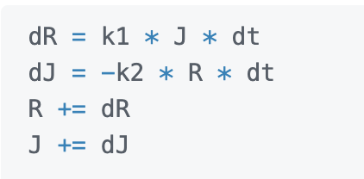
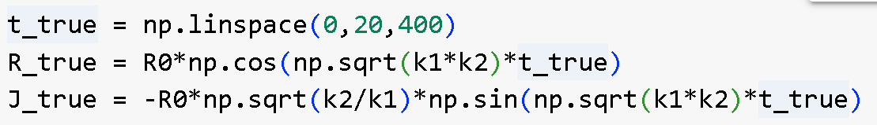
More code!
Implement this within your for loop!
Exact solutions

Slide 12
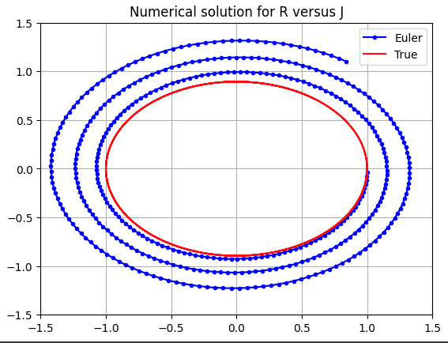
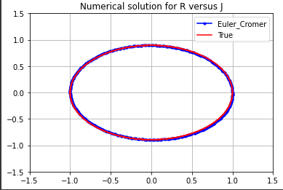
Euler vs Euler-Cromer
The Euler-Cromer approximation conserves energy!

Slide 13

Vectors

Slide 14
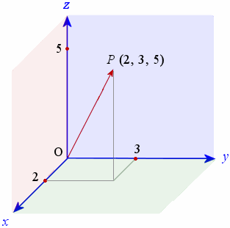
Vectors
A mathematical object with direction and magnitude
Examples: Position, Velocity, Acceleration, Force
In 3-dimensions, this is represented by 3 numbers
BUT does this mean any set of 3 numbers form a vector??

Slide 15
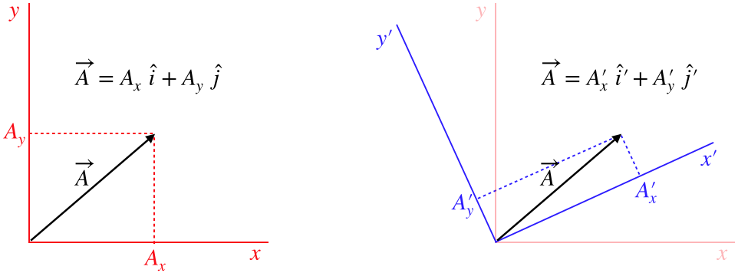
Vectors (with a bit more rigor)
Mathematical objects that obey specific transformation rules under rotations

Slide 16
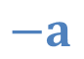
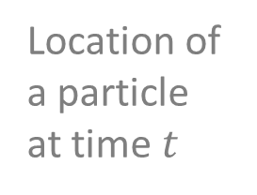

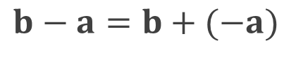
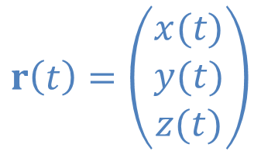
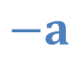
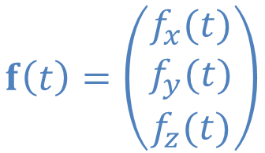
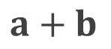
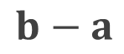


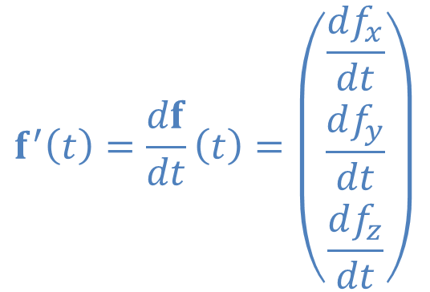
On vectors
$$r\left(t\right)=\left(\begin{matrix}x(t) \\ y(t) \\ z(t)\end{matrix}\right)$$
Location of a particle at time $t$
$$a+b$$
Position vector
Vector addition
$$b$$
$$a$$
$$f\left(t\right)=\left(\begin{matrix}f_{x}(t) \\ f_{y}(t) \\ f_{z}(t)\end{matrix}\right)$$
Vector function
$$−a$$
-a opposite direction to a
$$f^{′}\left(t\right)=\frac{df}{dt}\left(t\right)=\left(\begin{matrix}\frac{df_{x}}{dt} \\ \frac{df_{y}}{dt} \\ \frac{df_{z}}{dt}\end{matrix}\right)$$
$$−a$$
$$b−a=b+(−a)$$
$$b−a$$
$$b$$

Slide 17
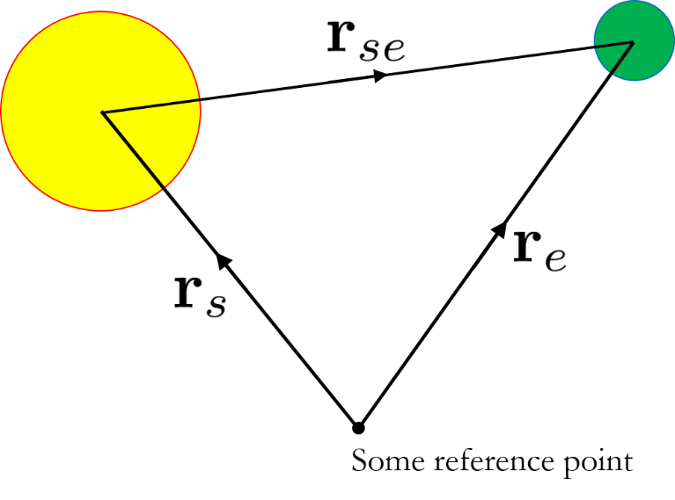
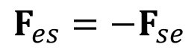
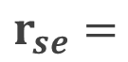
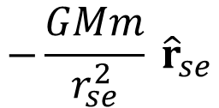
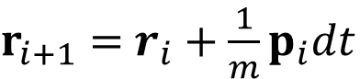
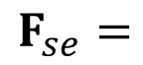
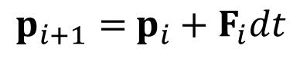
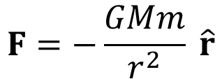
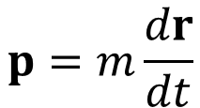
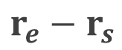
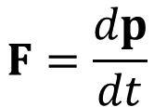
The Earth and the Sun, a two-body system
Setting up the position vectors
Differential equations
Define the forces
$$F=\frac{dp}{dt}$$
$$p=m\frac{dr}{dt}$$
$$F=−\frac{GMm}{r^{2}} \hat{r}$$
Numerical schemes
$$−\frac{GMm}{r_{se}^{2}} {\hat{r}}_{se}$$
$$F_{se}=$$
$p_{i+1}=$ $p_{i}+F_{i}dt$
$$r_{se}=$$
$$r_{e}−r_{s}$$
$$F_{es}=−F_{se}$$
$r_{i+1}=$ $r_{i}+\frac{1}{m}p_{i}dt$
Go to Activity 4 (lecture notes)

Slide 18

Two body problem

Slide 19
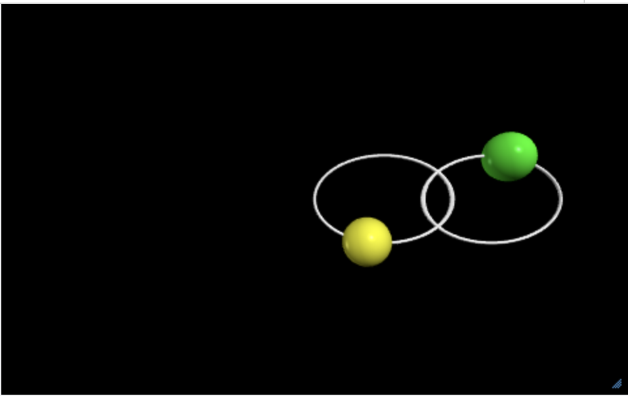
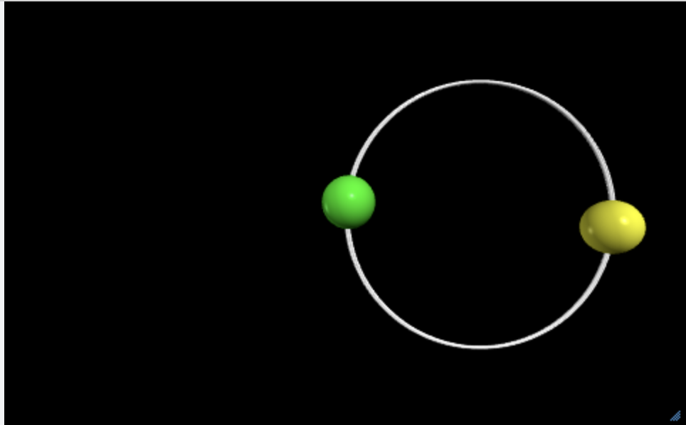
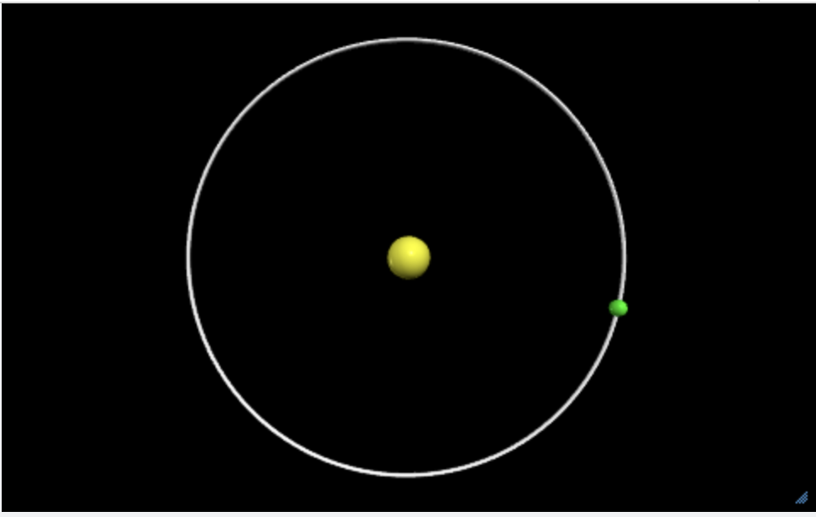
2 body problem
Experiment with the parameters to generate new orbits!

Slide 20

Discussion Questions

Slide 21
Q2
What is the benefit of solving the planetary motion problem numerically? What is the benefit of solving the planetary motion problem analytically?

Slide 22
Q2
What is the benefit of solving the planetary motion problem numerically? What is the benefit of solving the planetary motion problem analytically?
Benefit of solving numerically is that you can simply use a computer to calculate your result. It is much more convenient and you can solve complicated problems (such as 3 bodies). On the other hand, analytical method gives you exact solutions and it also provides you with equations that allow you to mathematically understand what is happening during the orbit. However, analytical solutions are not possible for N>2 body problems.

Slide 23
Q3
We saw a conserved quantity for the case of love. For planetary orbits, we saw that Kepler's second law is equivalent to the conservation of angular momentum. Other than angular momentum, is there another conserved quantity for planetary orbit?

Slide 24
Q3
We saw a conserved quantity for the case of love. For planetary orbits, we saw that Kepler's second law is equivalent to the conservation of angular momentum. Other than angular momentum, is there another conserved quantity for planetary orbit?
Energy is conserved! Can you prove it?

